Slide 1
Software Engineering
Course Contract ☺
Dr. Fatma ElSayed
Dr. Ahmed Yousry
Computer Science Department

Slide 2

Expectations?

Slide 3
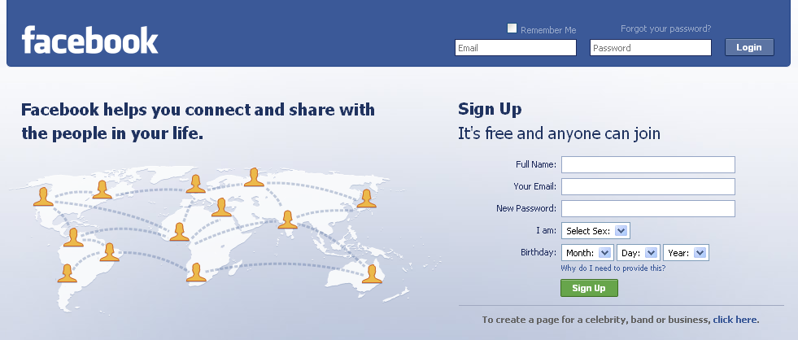
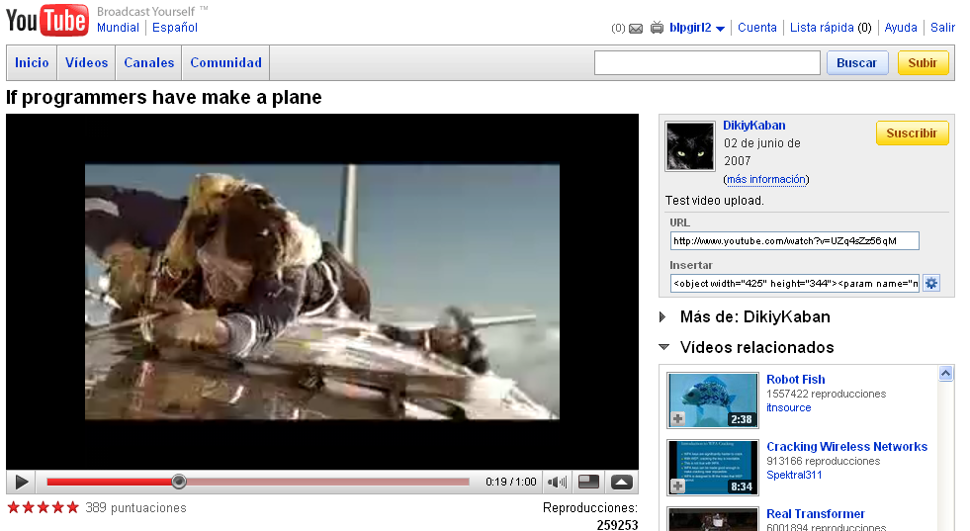
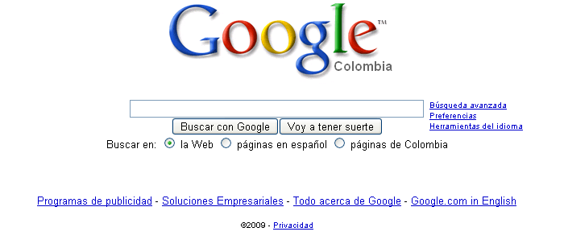
Where Can You Find Software?
Some popular ones…

Slide 4
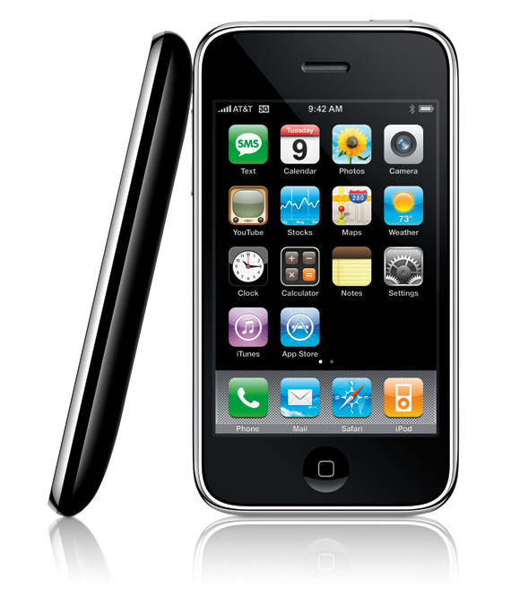

Where Can You Find Software?
And even in …

Slide 5
Conclusion
Software is everywhere and our society is now totally dependent on software-intensive systems.

Slide 6
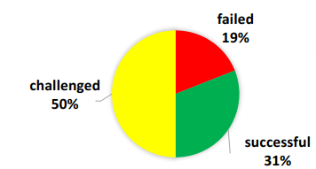
Project Success
The Standish group has been publishing reports on the success of software projects since 1994. In its report (2020) it defines:
Only 31% of all projects were being delivered on time, on budget, with the required features and functions.
.. 50% were late, or over budget, or not delivering all the required features.
.. 19% were either canceled before delivery or delivered but never used.

Slide 7
Common issues
Poor, or lack of, user involvement.
Lack of clear business objectives.
Under and over building –not building all the required features and building features that are never used.
Bad documentation.

Slide 8

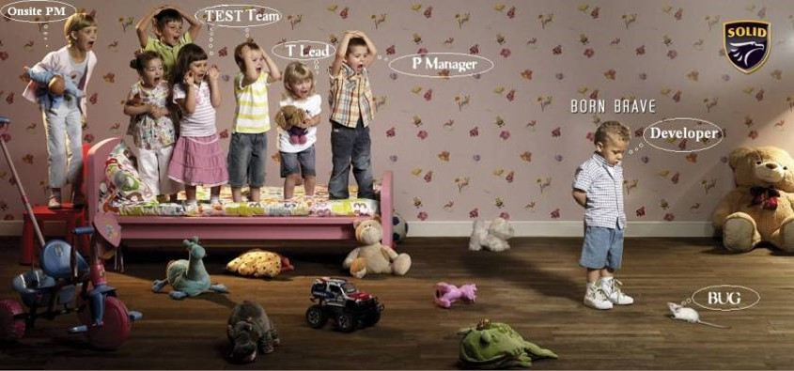
Software Engineering
Notes:
This professional campaign titled 'Born brave' was published in Poland in February, 2008., developer turn bug into feature

Slide 9
Phases for Software Development
Requirements Analysis
Software Design
Implementation
Testing
Maintenance

Slide 10
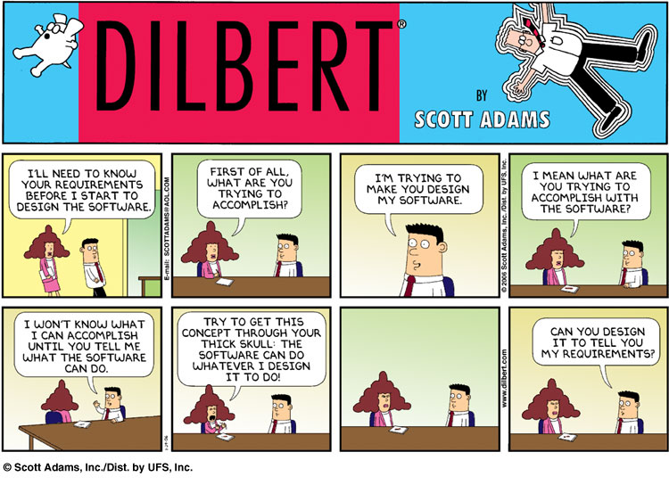
Requirement Analysis
Find out what the client want the software to do

Slide 11
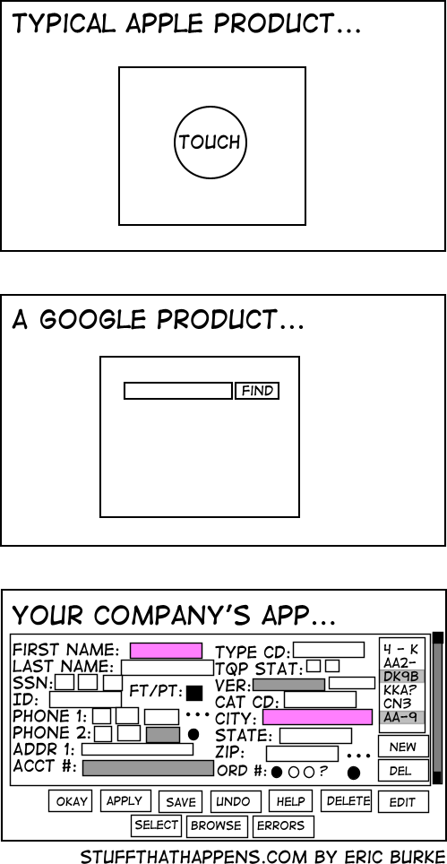
Design
Planning the software solution

Slide 12
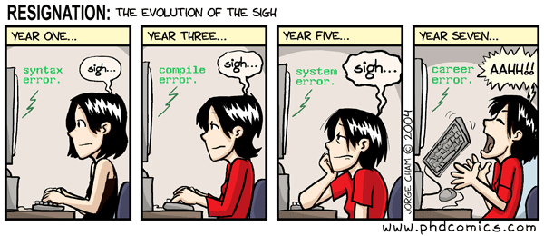
Implementation
Code!!!

Slide 13
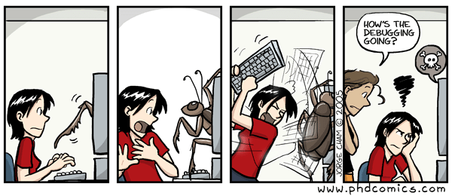
Testing
Executing the application trying to find software bugs

Slide 14
Maintenance
Any software engineering activity oriented to change an existing software product or to improve or plan for future changes.

Slide 15
Course Information

Slide 16
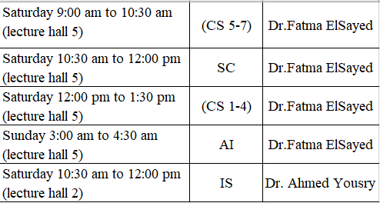
Course Information
Course Hours
Lecture:

Slide 17
Course Information and contact
Materials
All materials will be available at my BU page
link: https://bu.edu.eg/staff/ahmed.abdelsatar
Email: ahmed.abdelsatar@fci.bu.edu.eg
I need the admin to contact me for any further announcements.

Slide 18
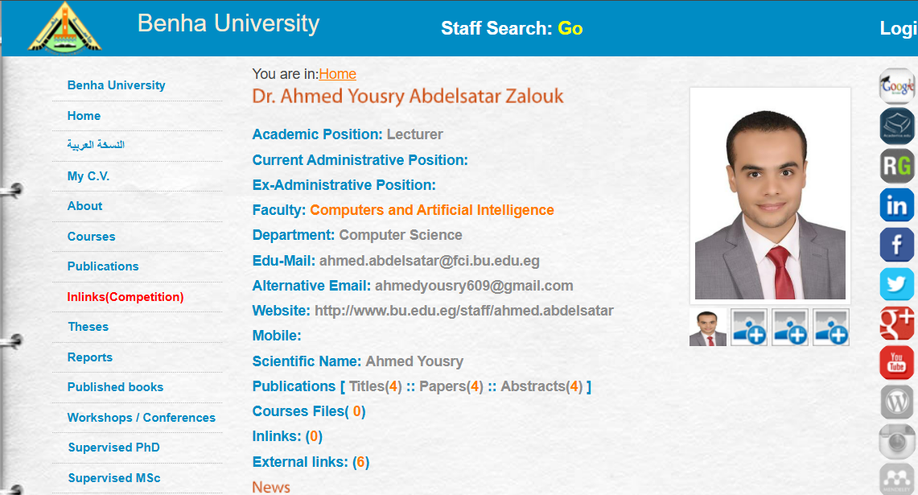
Course Information

Slide 19
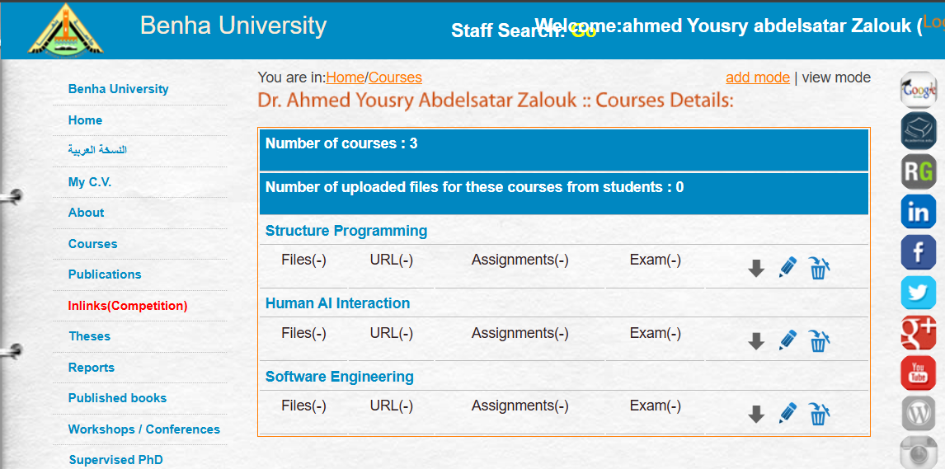
Course Information

Slide 20
Course Information
Grade Distribution*
- Total Grade 100
  Final Exam 50
  Year’s Work 50
- Year’s Work:
  Mid-Term Exam 20
  Labs 20
  Oral 10
*: subject to change during the term

Slide 21
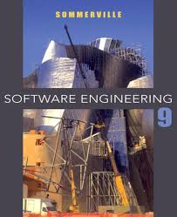
Course Information
Resources
Lecture Notes
Text Book
  Ian Sommerville, “Software Engineering”, 9th Edition, Addison Wesley.

Slide 22
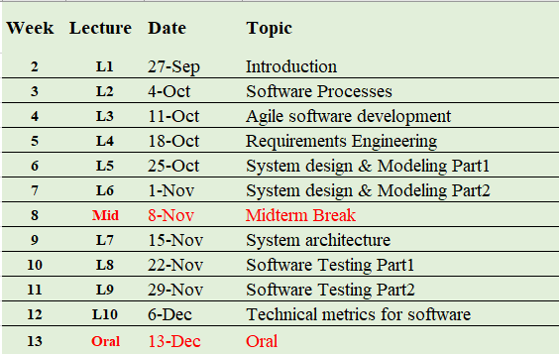
Course Information
Contents *
*: subject to change during the term

Slide 23


Finally…
”مـنْ غــشّنا فليس مـنـّـــا “
Cheating and copying is never ok ☹
Who will be caught cheating?
“Zero” score in that exam
“Publish” his name with the grade

Slide 24
Next: Introduction To Software Engineering

Slide 25
Thank you

